Slide 1
2
Introduction to C++ Programming

Slide 2
OBJECTIVES
In this chapter you will learn:
To write simple computer programs in C++.
To write simple input and output statements.
To use fundamental types.
Basic computer memory concepts.
To use arithmetic operators.
The precedence of arithmetic operators.
To write simple decision-making statements.

Slide 3
2.1 Introduction
2.2 First Program in C++: Printing a Line of Text
2.3 Modifying Our First C++ Program
2.4 Another C++ Program: Adding Integers
2.5 Memory Concepts
2.6 Arithmetic
2.7 Decision Making: Equality and Relational Operators

Slide 4
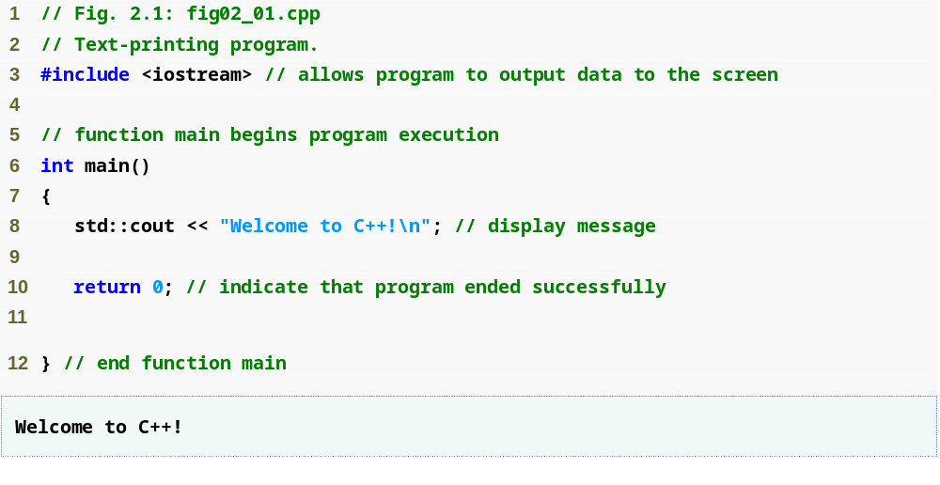
Outline
Single-line comments
Function main returns an integer value
Preprocessor directive to include input/output stream header file <iostream>
Left brace { begins function body
Function main appears exactly once in every C++ program
Statements end with a semicolon ;
fig02_01.cpp
(1 of 1)
fig02_01.cpp
output (1 of 1)
Corresponding right brace } ends function body
Stream insertion operator
Name cout belongs to namespace std
Keyword return is one of several means to exit a function; value 0 indicates that the program terminated successfully

Slide 5
2.2 First Program in C++: Printing a Line of Text (Cont.)
Preprocessor directives
  Processed by preprocessor before compiling
  Begin with #
  Example
    #include <iostream>
      Tells preprocessor to include the input/output stream header file <iostream>
White space
  Blank lines, space characters and tabs
  Used to make programs easier to read
  Ignored by the compiler

Slide 6
2.2 First Program in C++: Printing a Line of Text (Cont.)
Function main
  A part of every C++ program
    Exactly one function in a program must be main
  Can “return” a value
  Example
    int main()
      This main function returns an integer (whole number)
  Body is delimited by braces ({})
Statements
  Instruct the program to perform an action
  All statements end with a semicolon (;)

Slide 7
2.2 First Program in C++: Printing a Line of Text (Cont.)
Namespace
  std::
    Specifies using a name that belongs to “namespace” std
    Can be removed through use of using statements
Standard output stream object
  std::cout
    “Connected” to screen
    Defined in input/output stream header file <iostream>

Slide 8
2.2 First Program in C++: Printing a Line of Text (Cont.)
Stream insertion operator <<
  Value to right (right operand) inserted into left operand
  Example
    std::cout << "Hello";
      Inserts the string "Hello" into the standard output
        Displays to the screen
Escape characters
  A character preceded by "\"
    Indicates “special” character output
  Example
    "\n"
      Cursor moves to beginning of next line on the screen

Slide 9
2.2 First Program in C++: Printing a Line of Text (Cont.)
return statement
  One of several means to exit a function
  When used at the end of main
    The value 0 indicates the program terminated successfully
    Example
      return 0;

Slide 10
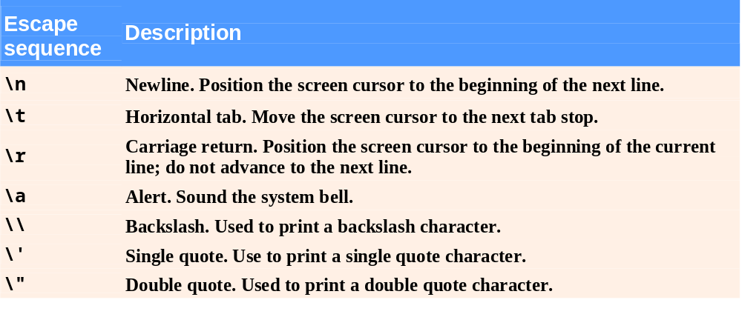
Fig. 2.2 | Escape sequences.

Slide 11
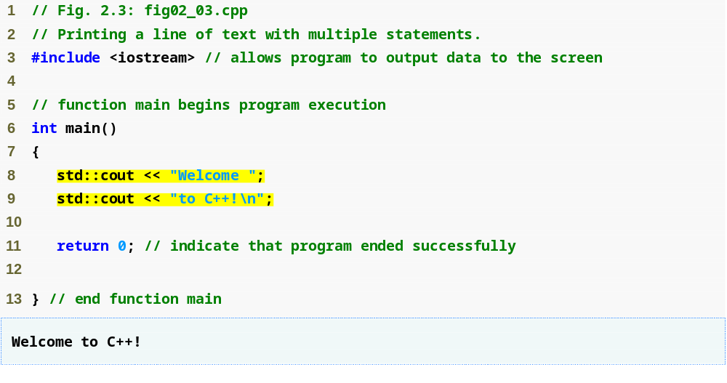
Outline
Multiple stream insertion statements produce one line of output
fig02_03.cpp
(1 of 1)
fig02_03.cpp output (1 of 1)

Slide 12
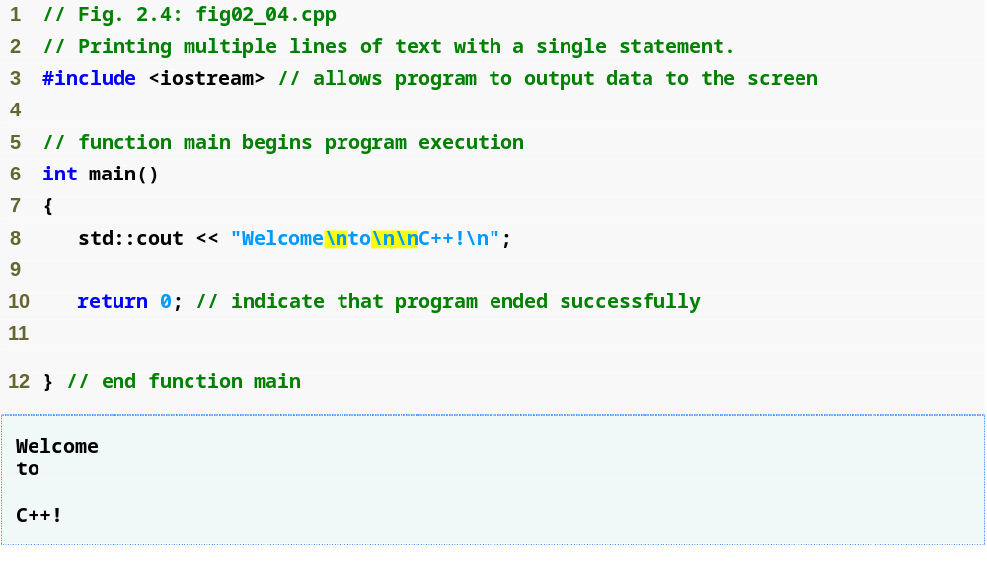
Outline
Use newline characters to print on multiple lines
fig02_04.cpp
(1 of 1)
fig02_04.cpp output (1 of 1)

Slide 13
2.4 Another C++ Program: Adding Integers
Variables
  Location in memory where value can be stored
  Common data types (fundamental, primitive or built-in)
    int – integer numbers
    char – characters
    double – floating point numbers
  Declare variables with name and data type before use
    int integer1;
    int integer2;
    int sum;

Slide 14
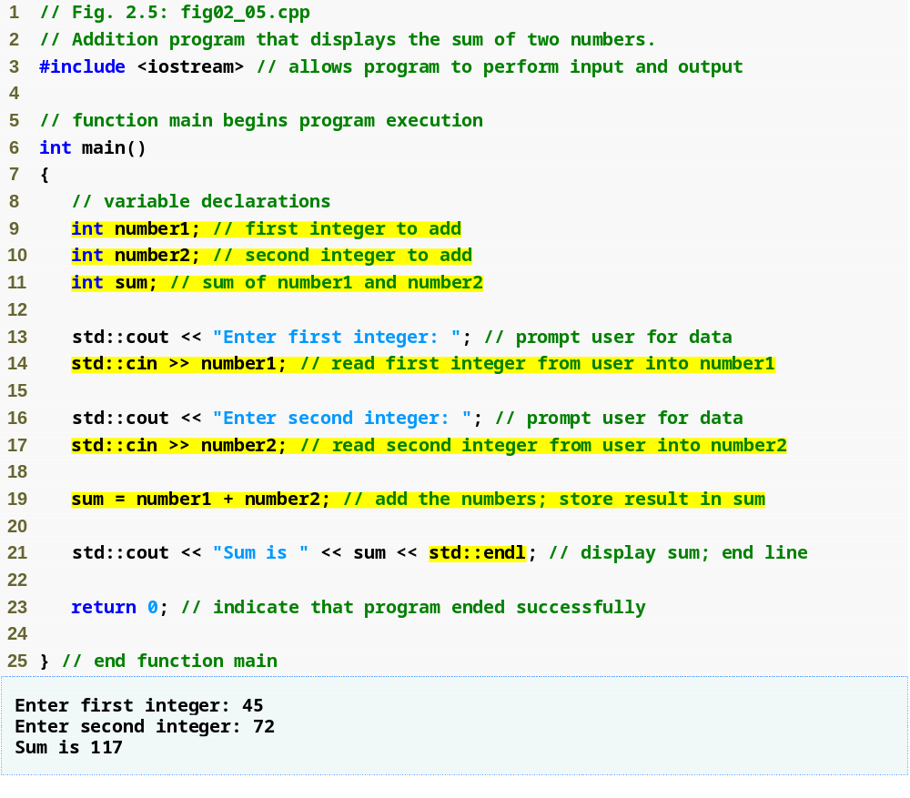
Outline
fig02_05.cpp
(1 of 1)
fig02_05.cpp output (1 of 1)
Declare integer variables
Use stream extraction operator with standard input stream to obtain user input
Stream manipulator std::endl outputs a newline, then “flushes output buffer”
Concatenating, chaining or cascading stream insertion operations

Slide 15
2.4 Another C++ Program: Adding Integers (Cont.)
Variables (Cont.)
  Can declare several variables of same type in one declaration
    Comma-separated list
    int integer1, integer2, sum;
  Variable names
    Valid identifier
      Series of characters (letters, digits, underscores)
      Cannot begin with digit
      Case sensitive

Slide 16
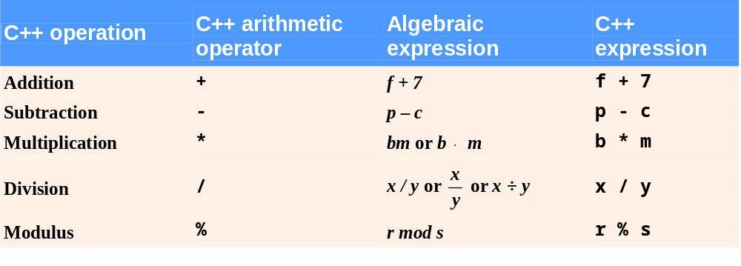
Fig. 2.9 | Arithmetic operators.

Slide 17
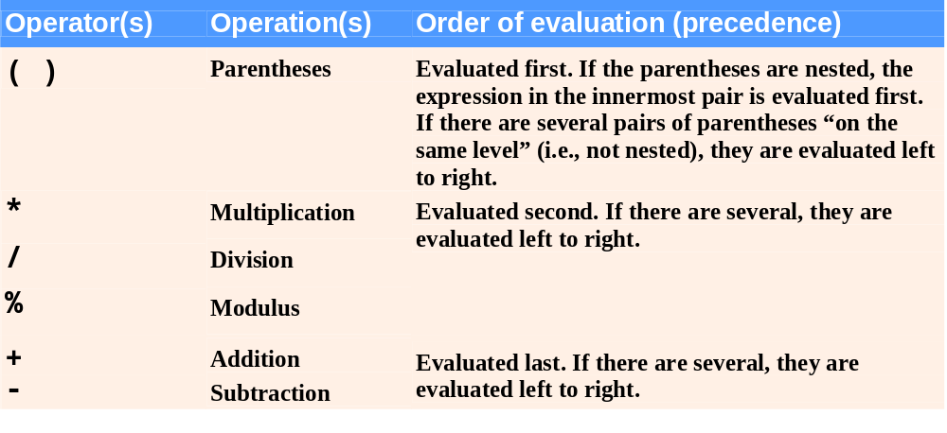
Fig. 2.10 | Precedence of arithmetic operators.

Slide 18
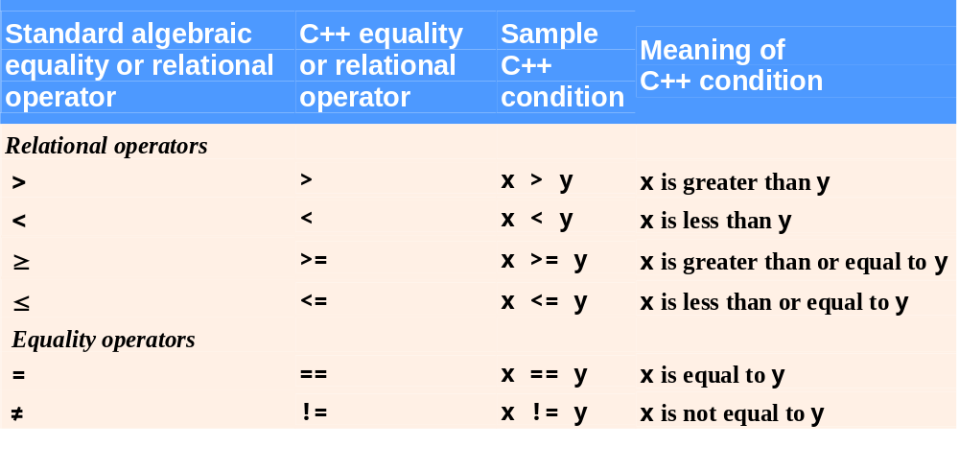
Fig. 2.12 | Equality and relational operators.

Slide 19
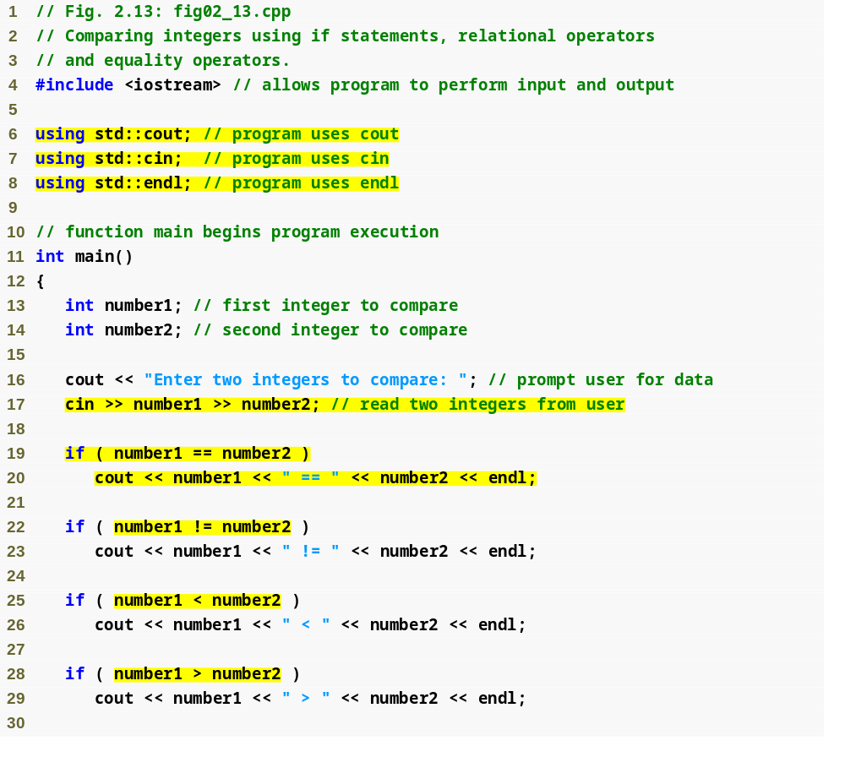
Outline
fig02_13.cpp
(1 of 2)
using declarations eliminate need for std:: prefix
Declare variables
Can write cout and cin without std:: prefix
if statement compares values of number1 and number2 to test for equality
If condition is true (i.e., values are equal), execute this statement
if statement compares values of number1 and number2 to test for inequality
If condition is true (i.e., values are not equal), execute this statement
Compares two numbers using relational operator < and >

Slide 20
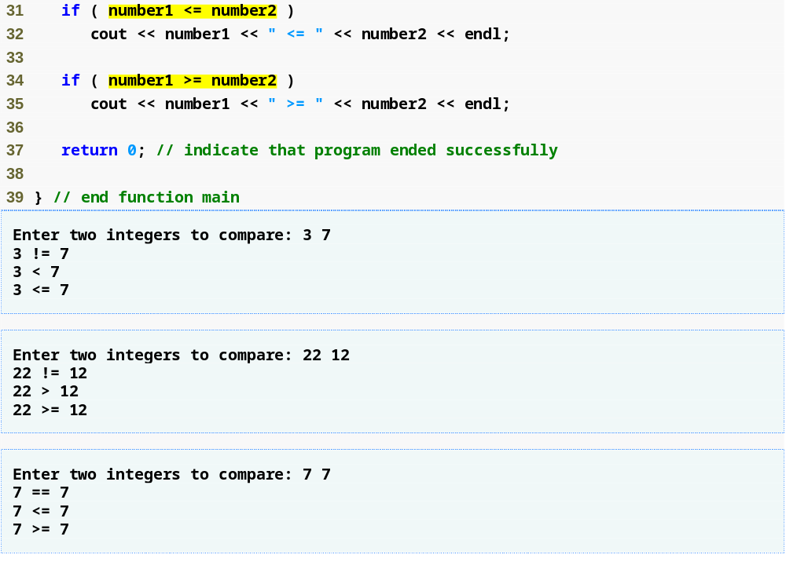
Outline
Compares two numbers using relational operators <= and >=
fig02_13.cpp
(2 of 2)
fig02_13.cpp output (1 of 3)
(2 of 3)
(3 of 3)

